Slide 1

INSTITUTE: UIE (AIT-CSE)
Computer Networks CST- 348
Lecture – 1.13
Switch working
By : Dr. Monica Luthra(e9836)
DISCOVER . LEARN . EMPOWER

Slide 2

Course Objectives
CO Number | Title
CO1 | Describe the important networking concepts
CO2 | Understand concept of network reference models and protocols
CO3 | Apply the concepts of routing algorithms on various networks
CO4 | Identify mechanism to handle traffic and control on congestion
CO5 | Identify and understand connection establishment techniques and features

Slide 3

Course Outcomes
After this course student will be able to:
To bring together several key of Computer network design and architecture
To Familiarize the student with the basic taxonomy and terminology of the computer networking area.
To Allow the student to gain expertise in some specific areas of networking such as the design and maintenance of individual networks.

Slide 4

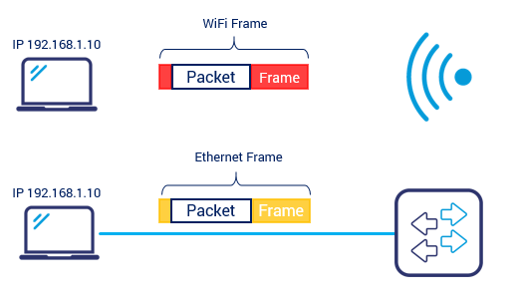
Switch
Ethernet Switch operates at Layer 2 (Data Link Layer)
Contrary to routers, Ethernet switches don’t understand IP packets but frames. As an IP packet has info for router, a frame has info for switch. What is the purpose of a frame? We have nowadays two most common types of network access:
Wireless medium – WiFi
Wired Ethernet medium – we often call it Cable/Wired or simply Ethernet
Image Source : https://www.grandmetric.com/2018/03/08/how-does-switch-work-2/

Slide 5
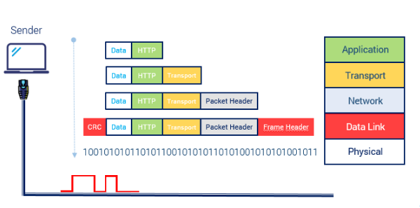
FRAME
Frame is a portion of information that allows for packet to traverse particular medium from one device interface to another. Ethernet, as an example, describes many technical parameters of how devices can access the network, how cable connectors should look, what speeds the transmission can achieve and finally how the bits and addressing are organized.
So layer 2 is strictly connected with type of medium or interface of device.
Take a look at the TCP/IP communication model to localize the Layer 2 (Data Link Layer). The Layer 2 is where the switch operates (marked in red).
Image Source : https://www.grandmetric.com/2018/03/08/how-does-switch-work-2/

Slide 6
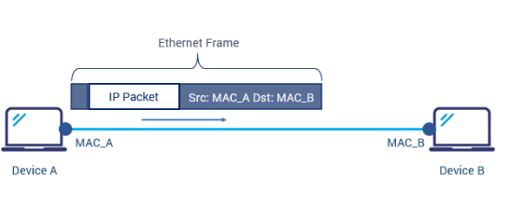
Ethernet Frame
Every IP device produces packets and they are forwarded across the network regardless of network access type.
Every access type uses its own structure to forward the data in its environment. Ethernet uses structure called Ethernet Frame.
Frame “surrounds” the packet as shown in below picture.
Image Source : https://www.grandmetric.com/2018/03/08/how-does-switch-work-2/

Slide 7
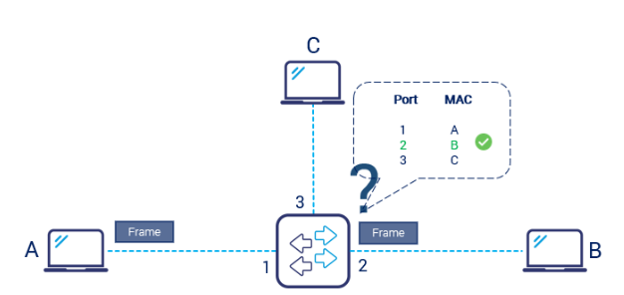
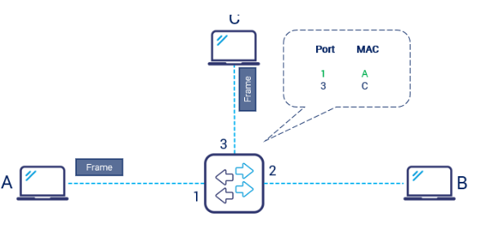
How does the switch work?
Switching process
When a frame arrives to a switch, the switch needs to direct the frame out through the right port, this redirection is called switching. When a frame enters into the switchport, the switch checks the dynamic table in memory which stores Physical Port and MAC address pairs. Switch then knows which port to use to forward the frame.
Remember: switch does not look into the IP packet and forwards frame as is based on destination MAC address.
How does the switch build the table? Switch learns the mac and port pairs in the process called MAC learning: When a frame first arrives at the switchport, the switch checks the source MAC address within the frame and stores it next to the port number on which it was received.
Image Source : https://www.grandmetric.com/2018/03/08/how-does-switch-work-2/

Slide 8
Key Points
Ethernet Switch operates at Layer 2 (Data Link Layer)
Frame is a portion of information that allows for packet to traverse particular medium from one device interface to another
switch does not look into the IP packet and forwards frame as is based on destination MAC address.

Slide 9
References
https://www.geeksforgeeks.org/basics-computer-networking/
https://www.youtube.com/watch?v=VwN91x5i25g&list=PLBlnK6fEyqRgMCUAG0XRw78UA8qnv6jEx
http://www.svecw.edu.in/Docs%5CCSECNLNotes2013.pdf
https://www.cloudflare.com/learning/ddos/glossary/open-systems-interconnection-model-osi/

Slide 10
THANK YOU
For queries
Email: monica.e9836@cumail.in

